Slide 1


Slide 2

C8
Sukannya Saha
ID: 011 151 079
Fazley Rabbi Biswas
ID: 011 151 096
Nazia Parvin Urmi
ID: 011 161 201

Slide 3

`
Paper Name
MusicMood: Predicting the mood of music from song lyrics using machine learning

Slide 4

Author
Sebastian Raschka
Michigan State University
Citation 01

Slide 5

Our Paper
BanglaMusicMooD : A music mood classifier from Bangla Music Lyrics

Slide 6

abstract
Predict the sentiment of songs based on song lyrics
Using Naïve Bayes classifier for lyrics classification
Manual labeling(mood and genre selection) based on lyrics

Slide 7
Plan

Slide 8
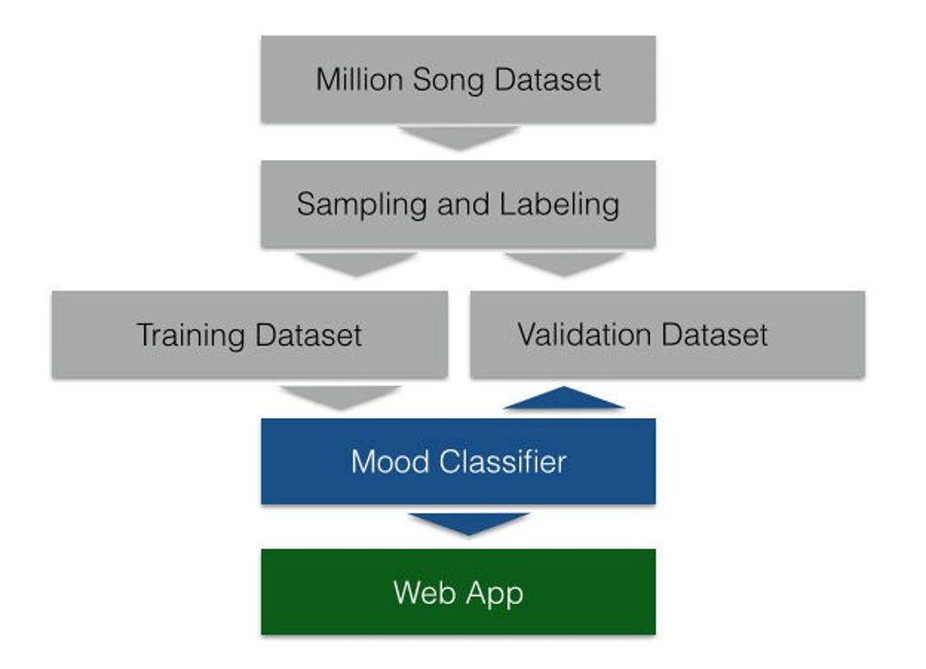
English
Creating dataset
Sampling and labeling each of the dataset
Divide dataset into training and validation part
Mood classifier : Using Naïve Bayes model
Two types of mood predict ( Happy and Sad)
Use web app to show the result of our model
ach of the dataset

Slide 9
Bengali
Bangla Lyrics Dataset
Encode With UTF - 8
Creating dataset manually
Sampling and labeling each of the dataset
Divide dataset into training and validation part
Mood classifier : Using Naïve Bayes model
Apply grid search
Store Two types of mood predict ( আনন্দ and বেদনা )
ach of the dataset
Sampling & Labeling
Training
Dataset
Validation
Dataset
Naïve BAYES Classifier
Grid Search
Store The New Type

Slide 10
Dataset ( English & Bengali ) word cloud

Slide 11
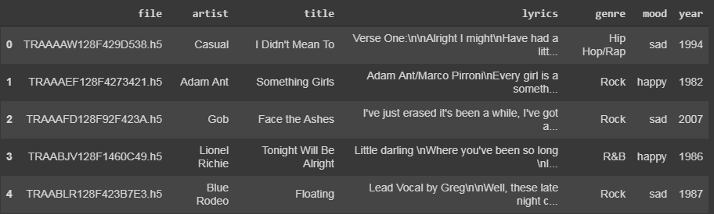
English dataset

Slide 12
dataset
Features
File
Artist
Title
Lyrics
Mood
Year
Genre
Most Focused
Features For
Word Cloud
Lyrics
Mood

Slide 13
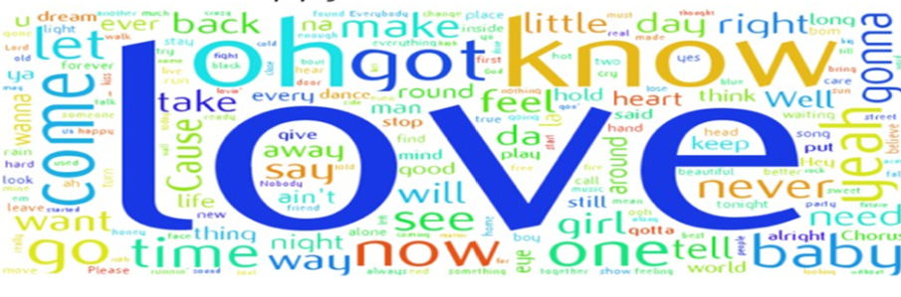

English Word Clouds
Happy
Sad

Slide 14
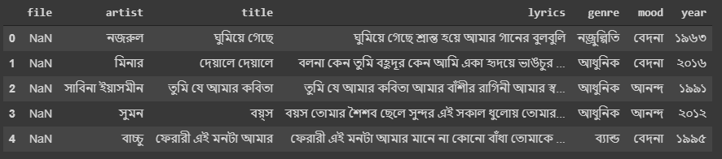
Bengali dataset

Slide 15
Bengali dataset
Features
Artist
Title
Lyrics
Mood
Year
Genre
Most Focused
Features For
Word Cloud
Lyrics
Mood

Slide 16

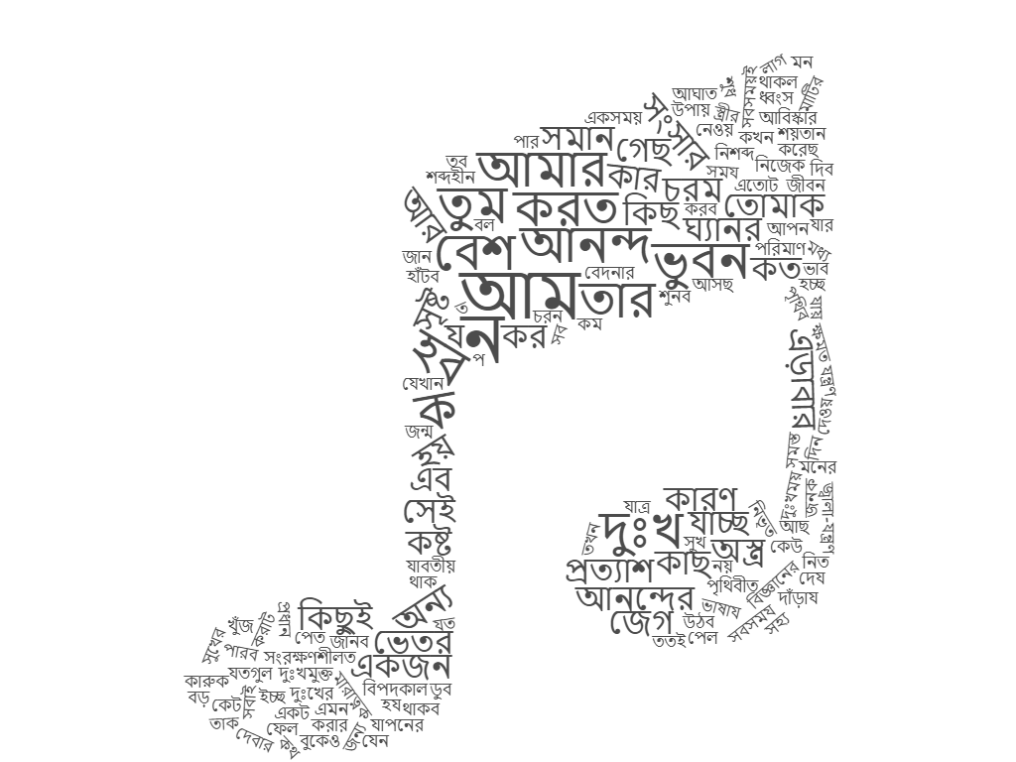
Word Clouds (Bengali songs)
আনন্দ
বেদনা

Slide 17
FEATURE EXTRACTION

Slide 18
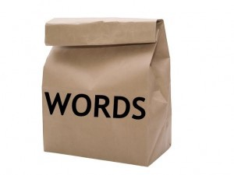
The bag of words model
Tokenization
Lyrics
Stop word removal
Frequency count

Slide 19
Tokenization & tokens
Process of splitting a sequence of lyrics into a list of tokens.
String of contiguous characters between two spaces and punctuation marks.
Tokenization
Tokens

Slide 20
Types of Tokenization
Tokenization
From paragraph
From sentence
Into sentences
Into words

Slide 21
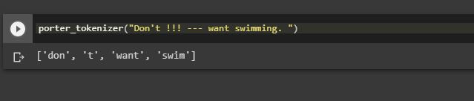
Tokenization into words from English dataset

Slide 22
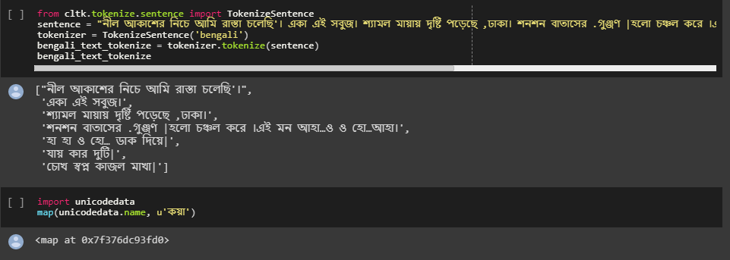
Tokenization into sentences form Bengali dataset

Slide 23
Tokenization method
Lyrics
v
Porter Stemmer
Stemming
Suffix stripping
token
(stem word)

Slide 24
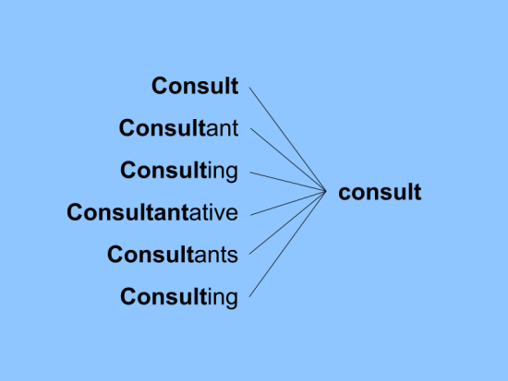
STEMMING
Reduces a word to its stem or base form.
Result is less readable by humans.
Makes text more comparable across observations.
STEM

Slide 25
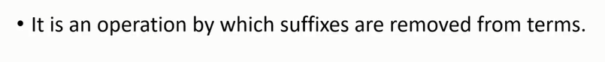
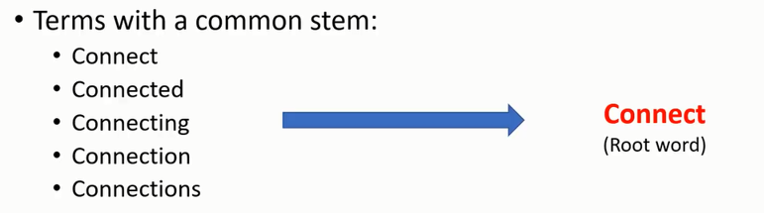
Suffix stripping

Slide 26
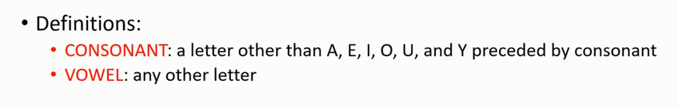
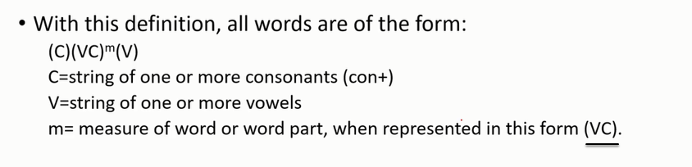
Porter stemmer

Slide 27
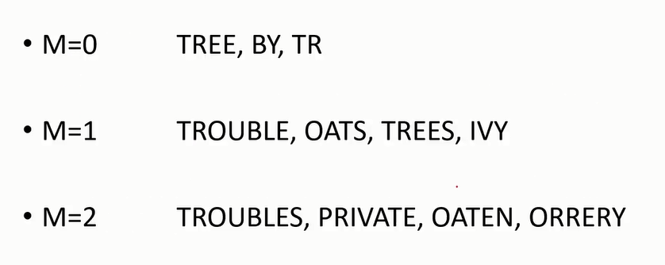
Porter stemmer
Measure of word(m)
VC
T R E E
C
C
V
V
V C
M = 0
V C
V C

Slide 28
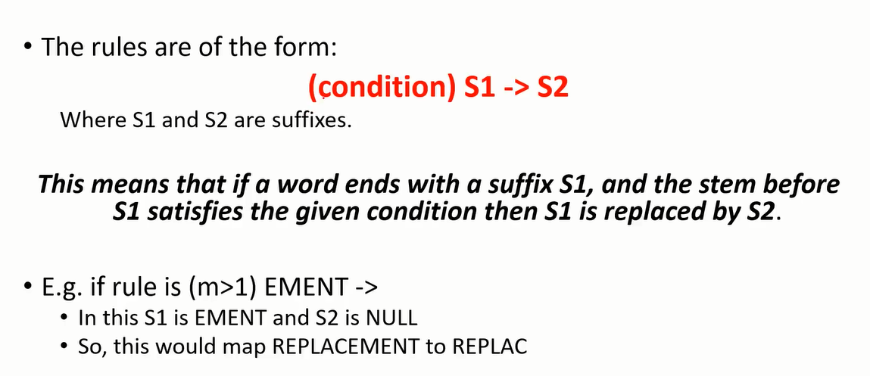
RULE FOR REMOVING A SUFFIX
Replacement
m = 4
Replacement -> Replac

Slide 29
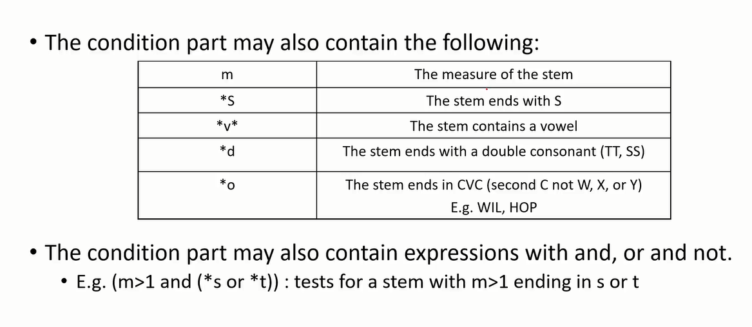
RULE FOR REMOVING A SUFFIX

Slide 30
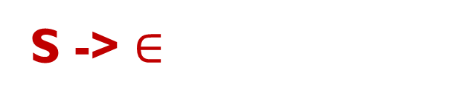
Step - 1(a)
SSES -> SS
IES -> I
Caresses -> caress
Ties -> ti
SS -> SS
S ->$∈$
Caress -> caress
Cats -> cat

Slide 31
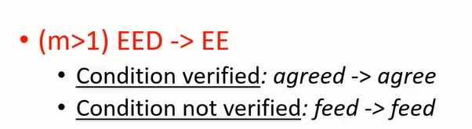
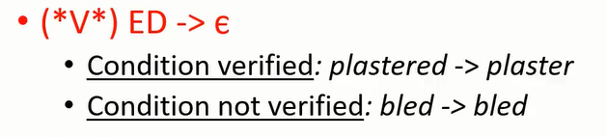
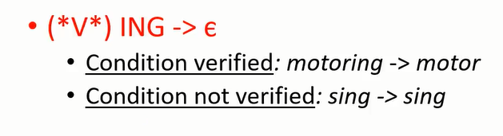
Step – 1(b)
cv
0
(m != 0)
v
v

Slide 32
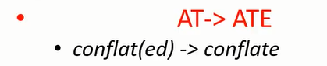
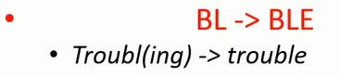
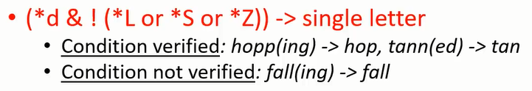
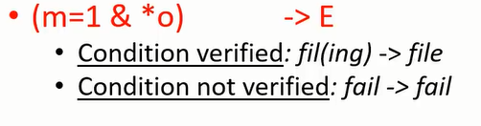
cleanup

Slide 33
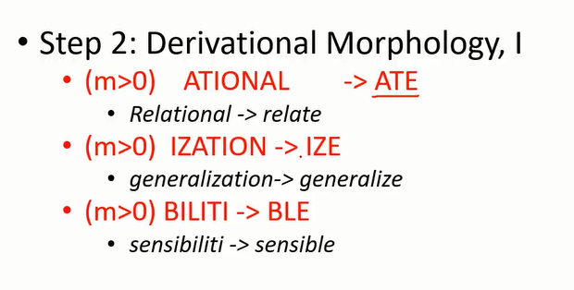
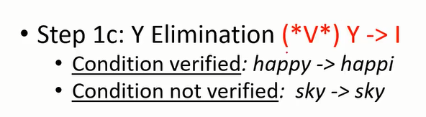
Step – 1(c) & STEP – 2

Slide 34
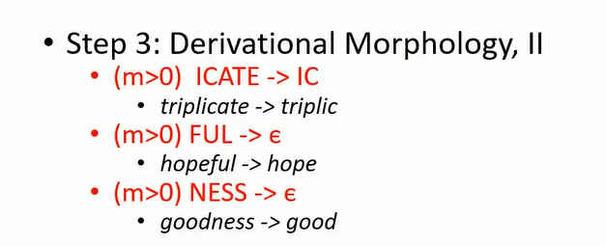
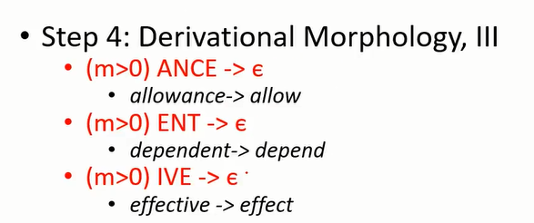
STEP – 3 & 4

Slide 35
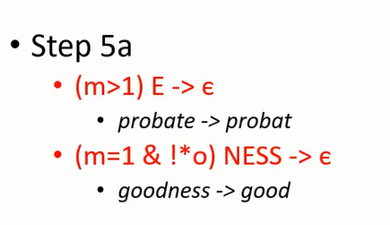
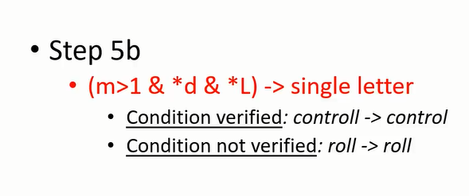
STEP – 5

Slide 36
Porter Stemming from English dataset

Slide 37
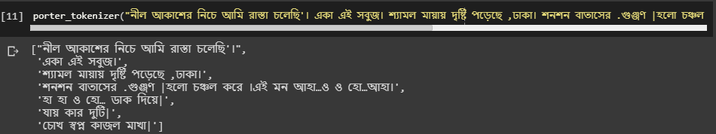
Porter Stemming from Bengali dataset

Slide 38
Stop Word Removal
Input Tokenized
Dataset
“the” “function” “signature” “include” “the” “name” “of” “the” “function” “and” “the” “types” “of” “the” “parameters”
Remove stop word process (collect the stop words from the sentence and avoid it
“the” “the” “of” “the” “and” “the” “of” “the”
“function” “signature” “include” “name” “function” “types” “parameters”
Result

Slide 39
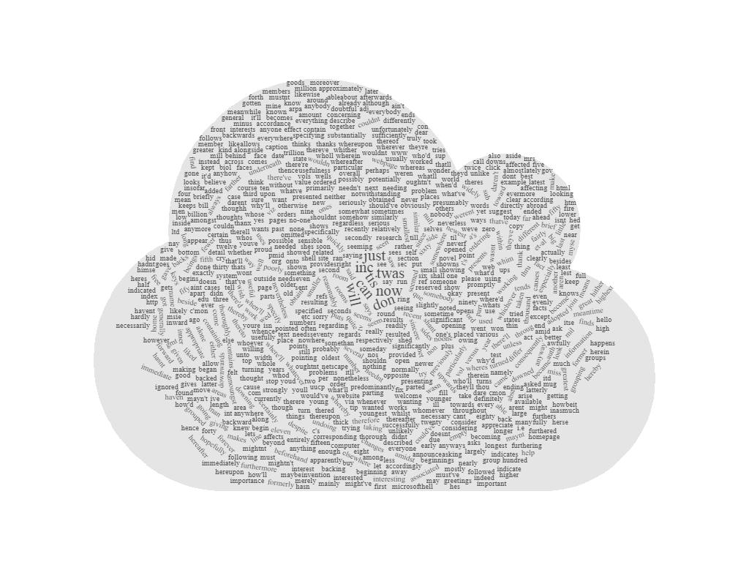
Stop Word could for English dataset

Slide 40
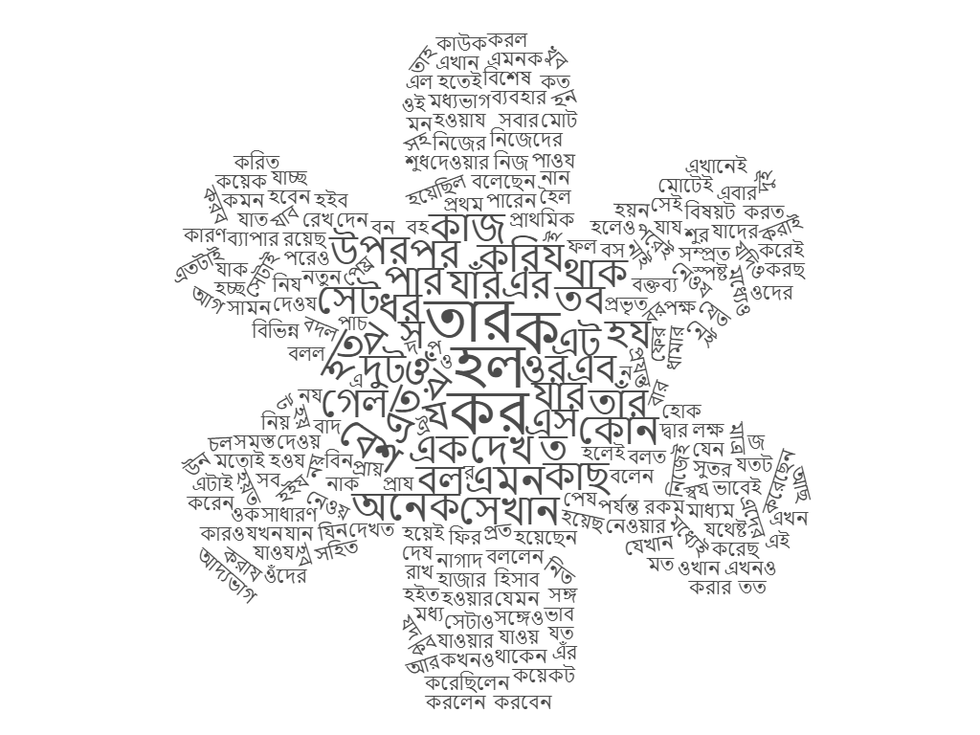
Stop Word cloud for Bengali dataset

Slide 41
Choosing vocabulary
N – gram
vocabulary of grouped words
to reduce size

Slide 42
N-grams
An N-gram is an N-token sequence of words.
n : 2 characters , 3 words or 2 sentences
Unigram(n = 1) : one-word sequence of word
Bigram(n = 2) : two-word sequence of words
Trigram(n =3) : three-word sequence of words

Slide 43
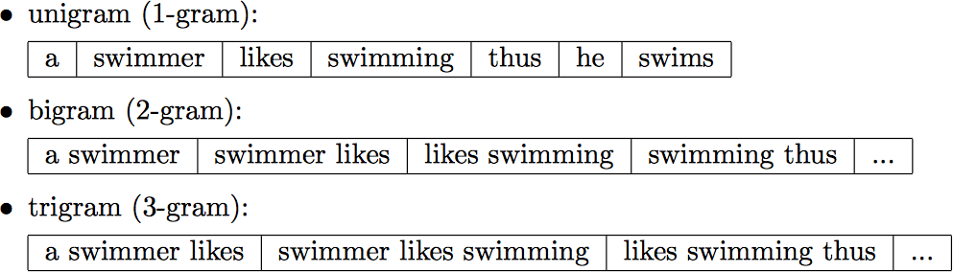
N-grams for words
“a swimmer likes swimming thus he swims”

Slide 44
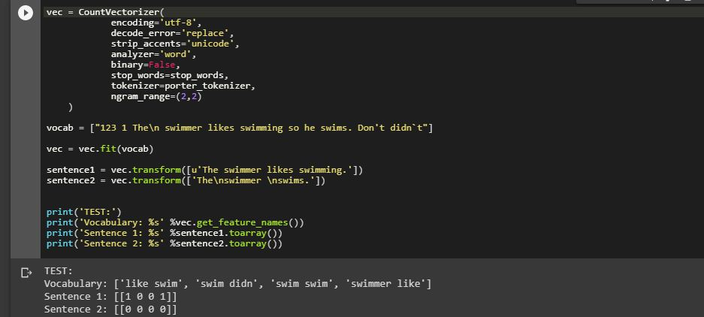
BI-GRAM(N = 2) in English dataset

Slide 45

Scoring words
frequency count
TF – IDF

Slide 46
Term Frequency - Inverse Document Frequency (Tf-idf)
Used to get more important features from
document with weights.
TF – IDF = TF (t,d) * IDF (t)
Term Frequency
Inverse document Frequency

Slide 47
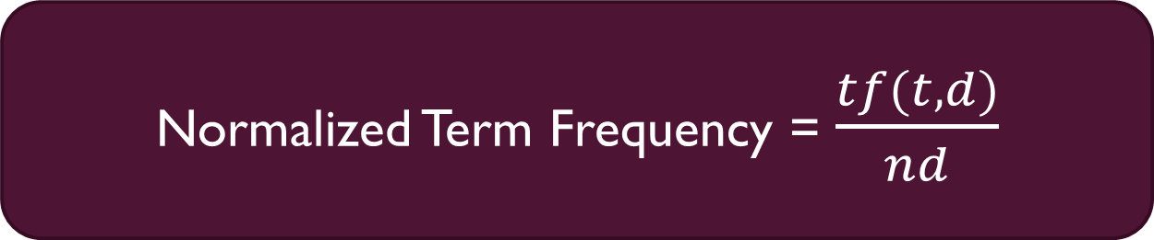
Normalized Term Frequency
Normalized Term Frequency = $\frac{tf(t,d)}{nd}$
Where,
Tf(t,d) : the number of occurrences of a term t in a song text d
nd : total number of lyrics that contain the term t

Slide 48

Inverse document Frequency
idf(t) = $\log_{2}{\frac{1+nd}{1+df\left(d,t\right)}}$ +1
Where,
nd : total number of lyrics
df (d,t) : the number of lyrics that contain the term t

Slide 49

Feature vector
Matrix representation of words

Slide 50
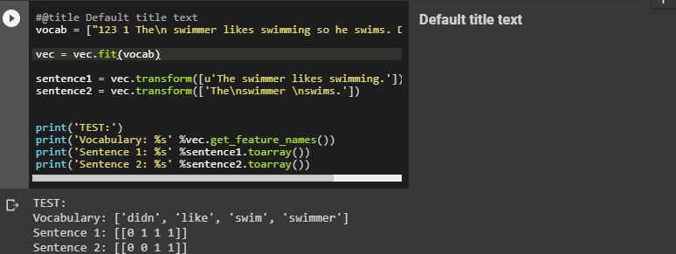
Feature Vectors for English dataset

Slide 51
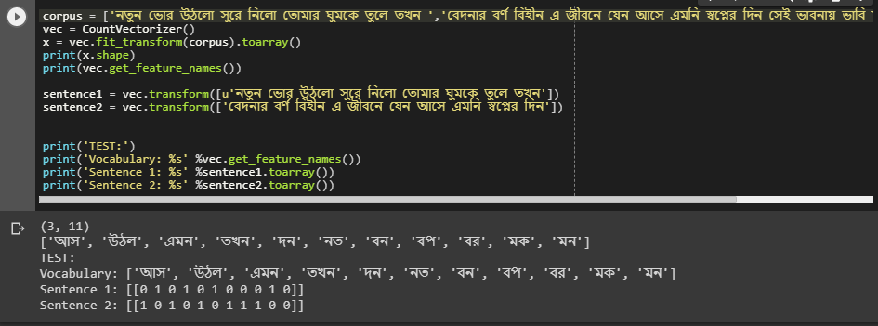
feature vector for Bengali dataset

Slide 52
Model development

Slide 53
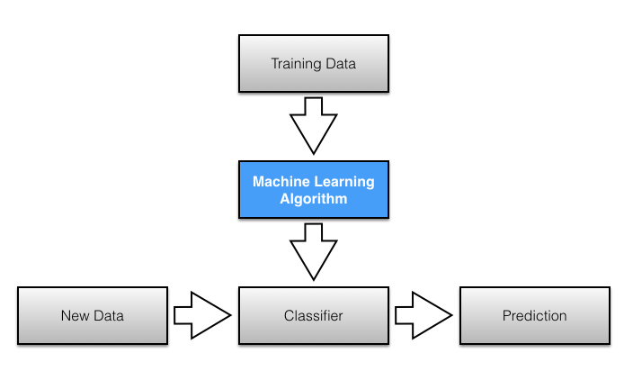
Model selection

Slide 54
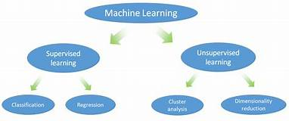
Model selection

Slide 55
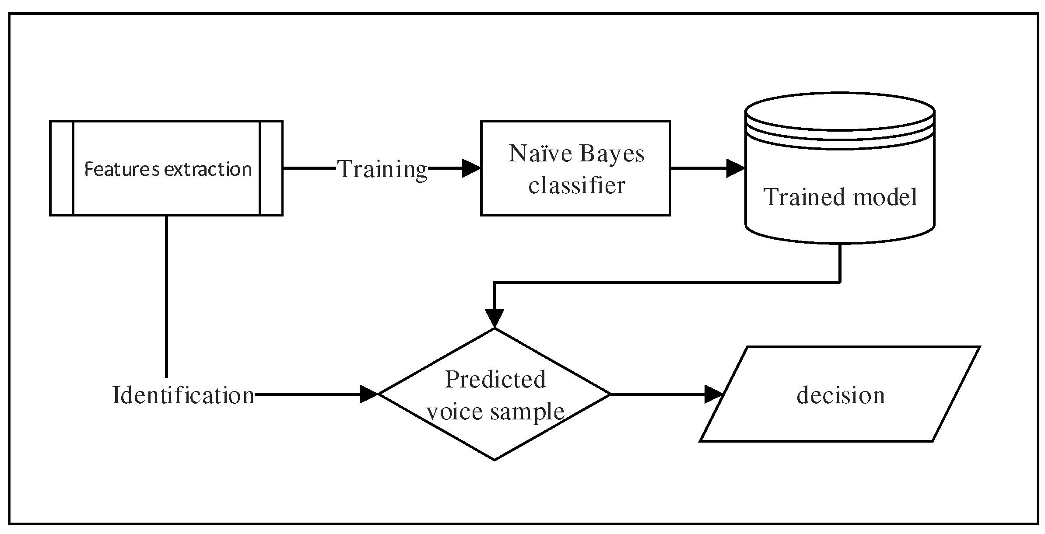
Model selection

Slide 56
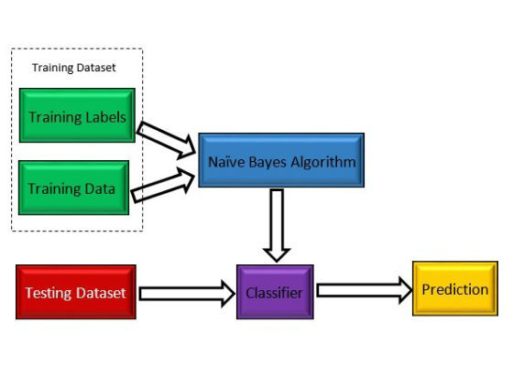
Model selection

Slide 57
Why naïve bayes classifier
Labeled data set for training to classify the unlabeled data
Useful for huge dataset
Easy to implement and highly scalable
To represent the probabilistic relationship between different classes

Slide 58



Naïve Bayes classifier
Class Conditional
Probability
P(Wj | Xi) = $\frac{P\left(Xi \right|Wj) . P(Wj)}{P(Xi)}$
P(Wj | Xi) = $\frac{P\left(Xi \right|Wj) . P(Wj)}{P(Xi)}$
P(Wj | Xi) = $\frac{P\left(Xi \right|Wj) . P(Wj)}{P(Xi)}$
P(Wj | Xi) = $\frac{P\left(Xi \right|Wj) . P(Wj)}{P(Xi)}$
Prior Probability
Posterior
Probability
Evidence

Slide 59
Prior probability
Day | Outlook | Temperature | Humidity | Wind | Play
D1 | Sunny | Hot | High | Weak | No
D2 | Sunny | Hot | High | Strong | No
D3 | Overcast | Hot | High | Weak | Yes
D4 | Rain | Mild | High | Weak | Yes
D5 | Rain | Cool | Normal | Weak | Yes

Slide 60



Prior probability
3/5
2/5

Slide 61
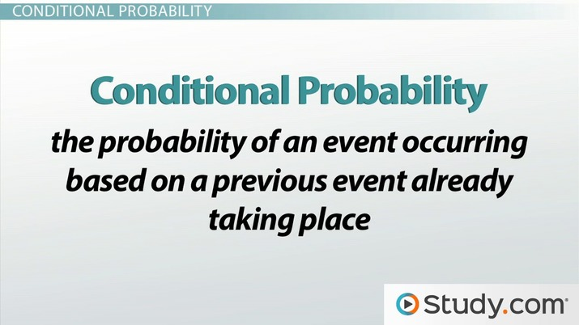

Slide 62
Class conditional probability
Day | Outlook | Temperature | Humidity | Wind | Play
D1 | Sunny | Hot | High | Weak | No
D2 | Sunny | Hot | High | Strong | No
D3 | Overcast | Hot | High | Weak | Yes
D4 | Rain | Mild | High | Weak | Yes
D5 | Rain | Cool | Normal | Weak | Yes

Slide 63
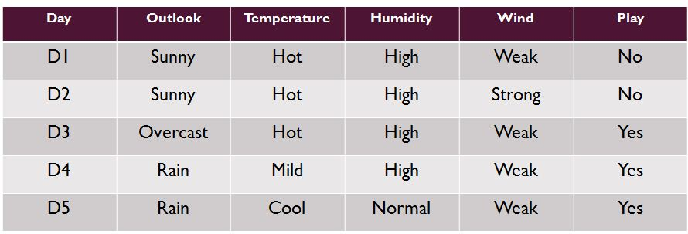


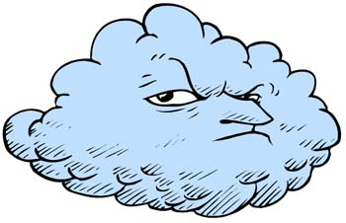


Class conditional probability
Outlook
1/3
0/2
0/3
2/2
2/3
0/2

Slide 64



CLASS CONDITIONAL probability
Temperature
2/2
1/3
0/2
1/3
1/3
0/2

Slide 65


CLASS CONDITIONAL probability
Humidity
1/3
0/2
2/3
2/2

Slide 66
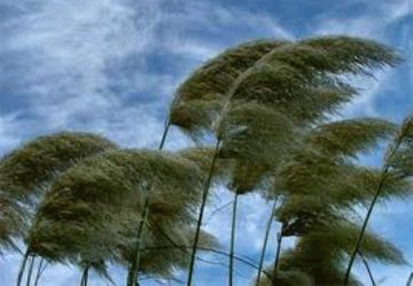

CLASS CONDITIONAL probability
Wind
0/3
1/2
3/3
1/2

Slide 67



CLASS CONDITIONAL probability
For D3,
.
.
= 0.07
.

Slide 68

CLASS CONDITIONAL probability
For D3,
.
.
= 0.00
.

Slide 69


Posterior probability
0.6 * 0.07 = 0.042
0.4 * 0.00 = 0.00

Slide 70
Multivariate Bernoulli Naive Bayes
Naïve Bayes classifier
Multinomial naive Bayes

Slide 71
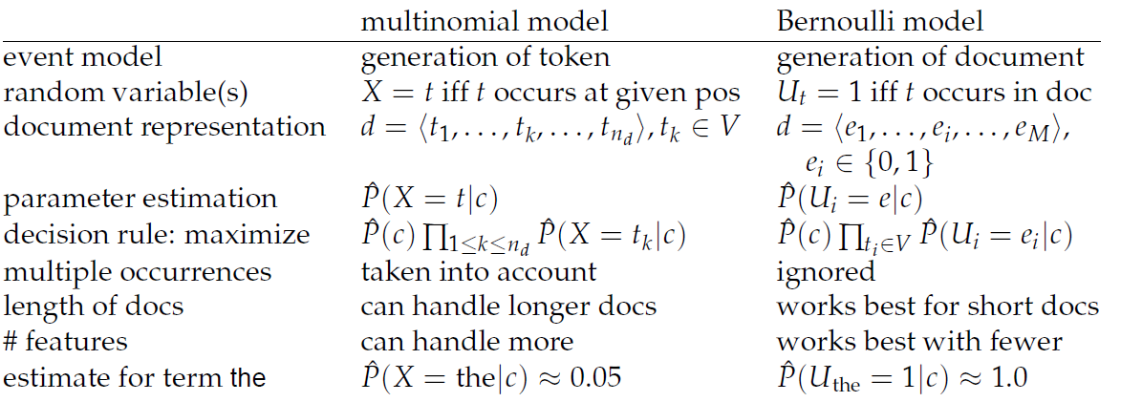

Slide 72
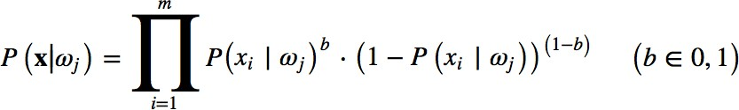
Multivariate Bernoulli Naive Bayes
Where,
Xi : a particular word or token
Wi : class
for binary features

Slide 73
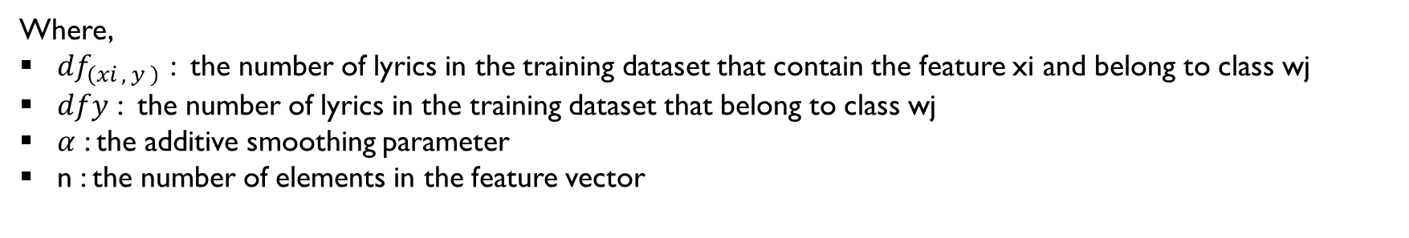

Multivariate Bernoulli Naive Bayes
P(x|$w_{j}$) = $\frac{{df}_{\left(xi , y \right) }+ α}{{df}_{y}+ αn}$
Where,
${df}_{\left(xi , y \right) }$: the number of lyrics in the training dataset that contain the feature xi and belong to class wj
$df﷮y$ : the number of lyrics in the training dataset that belong to class wj
$α$ : the additive smoothing parameter
n : the number of elements in the feature vector

Slide 74
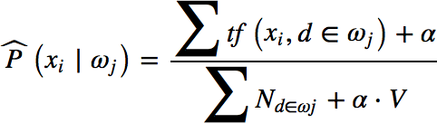

Multinomial naive Bayes
Where,
$∑N_{d∈wj }$: the sum of all term frequencies in the training dataset that belong to wj

Slide 75
Model evaluation

Slide 76

Grid search
Grid-search is used to find the optimal hyperparameters of a model which results in the most ‘accurate’ predictions.

Slide 77
Cross Validation
Exhaustive cross-validation:
Exhaustive cross-validation methods are cross-validation methods which learn and test on all possible ways to divide the original sample into a training and a validation set.
Leave-p-out cross-validation
Leave-one-out cross-validation
Non-exhaustive cross-validation:
Non-exhaustive cross validation methods do not compute all ways of splitting the original sample. Those methods are approximations of leave-p-out cross-validation.
k-fold cross-validation

Slide 78
K-Fold Cross-Validation
Probably the simplest and most widely used method for estimating prediction error.
This method directly estimates the average prediction error when the machine learning method is applied to an independent test sample.
If we had enough data, we would set aside a validation set and use it to assess the performance of our prediction model.
To finesse the problem, K-fold cross-validation uses part of the available data to fit the model, and a different part to test it.

Slide 79
K-Fold Cross-Validation
›To work around this issue k-fold CV works as follows:
1. Split the sample into k subsets of equal size
2. For each fold, estimate a model on all the subsets except one
3. Use the left out subset to test the model, by calculating a CV metric of choice
4. Average the CV metric across subsets to get the CV error

Slide 80

10-fold Cross Validation

Slide 81
performance

Slide 82

F1, PRECISION, RECALL
true positives (TP): These are cases in which we predicted yes (they have the disease), and they actually do.
true negatives (TN): We predicted no, and they actually don't.
false positives (FP): We predicted yes, but they actually don't . (Also known as a "Type I error.")
false negatives (FN): We predicted no, but they actually do yes. (Also known as a "Type II error.")

Slide 83


F1, PRECISION, RECALL
F1 = 2 * $\frac{precision ∗recall}{precision + recall}$

Slide 84


PRECISION
What do you notice for the denominator? The denominator is actually the Total Predicted Positive! So the formula becomes

Slide 85


RECALL
So Recall actually calculates how many of the Actual Positives our model capture through labeling it as Positive (True Positive).

Slide 86

F1 score
F1 Score is a function of Precision and Recall.
F1 Score is needed when you want to seek a balance between Precision and Recall.
what is the difference between F1 Score and Accuracy ?

Slide 87


Result for English dataset
Training
Validation

Slide 88

Result for English dataset

Slide 89


Result for Bengali dataset
Training
Validation

Slide 90

Result for Bengali dataset

Slide 91
Softwares
Colab
pychram

Slide 92
Tools
English dataset
Bengali dataset
NLTK
Corpus
CLTK
Corpus importer
Bengali dictionary

Slide 93


